Slide 1
Media Player
By :
Maharshi Pancholi
07DCE053
Akshar Patel
07DCE060
Guide :
Prof. Rahul Shrmali

Slide 2
Company Profile
Viva solution is company working on mobile application development.
It is working on different mobile technologies like Android, IPhone, Blackberry, Symbian , Brew and Windows Mobile

Slide 3
Project Definition
Media Player is android application that can play various audio and video files.

Slide 4
Project Profile
Project Title | Media Player
Aim | To play different audio and video files in the android operating system based mobiles.
Project Category | Mobile Application
Technology | Java & XML
Platform | Android 2.3.3
IDE | Eclipse 3.6.1
Operating System | Ubuntu 10.10 & Fedora 14

Slide 5
Objectives
Easy to use interface
Support for Vertical and Horizontal orientation
Application will be written using Android SDK in Java and should run on all Android OS handsets.
Background playing options.
Notification on the home screen.

Slide 6
Requirements
Ability to play Audio and Video file
Welcome Screen
Main Screen
Player Screen

Slide 7
Development
Tools & Technology
Eclipse 3.6.1 with ADT plug-in
Android SDK 10r
Android 2.3.3 lib
Java
XML

Slide 8

Android

Slide 9
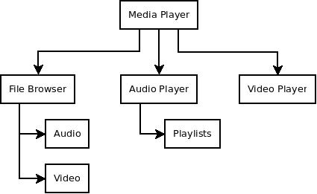
System Chart

Slide 10
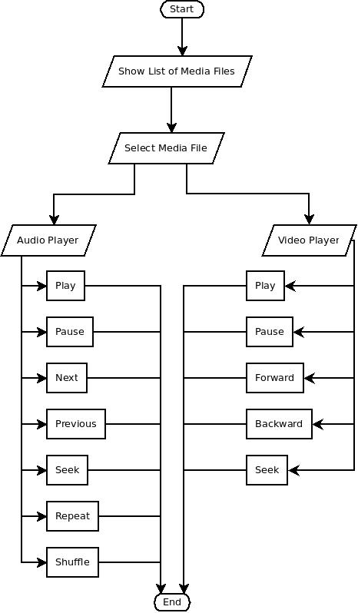
Flow Chart

Slide 11
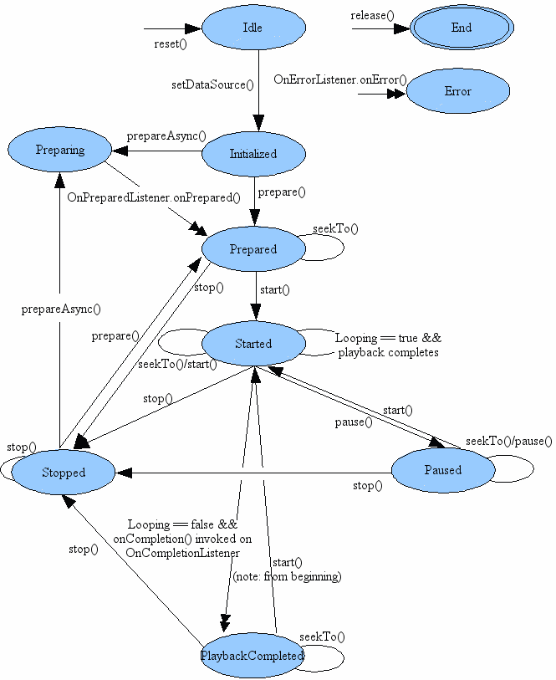
State Diagram

Slide 12
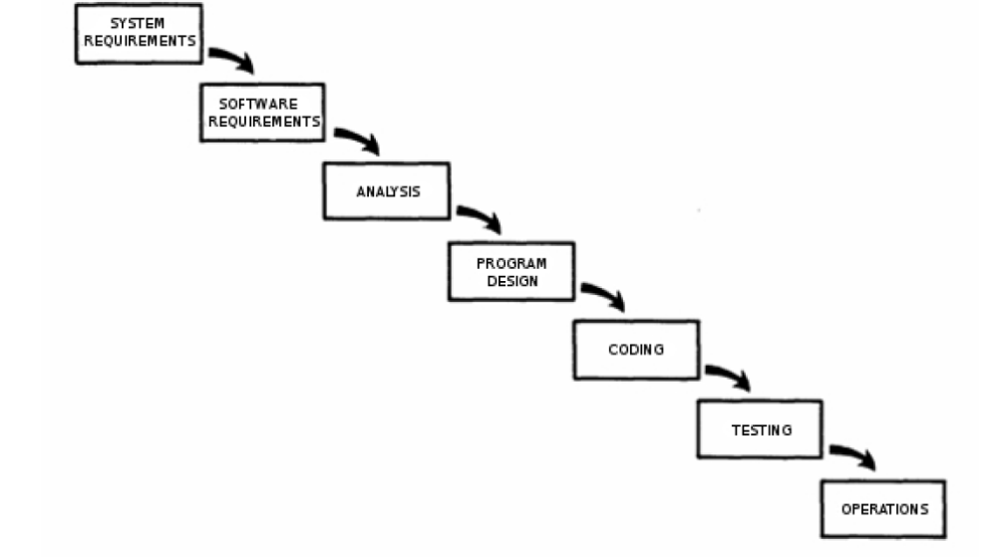
Waterfall Model

Slide 13
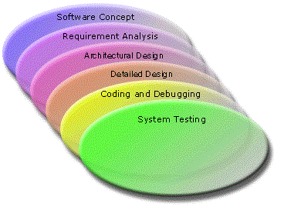
Sashimi Mode

Slide 14
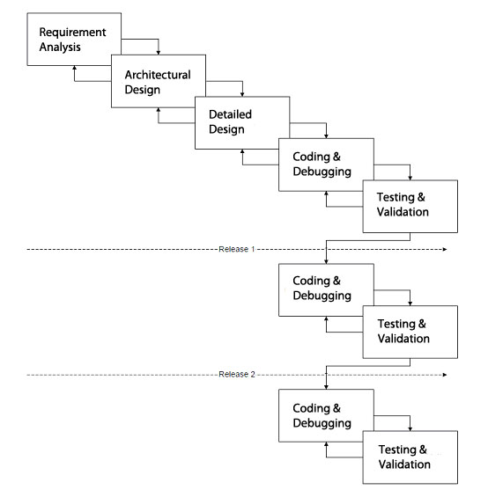
Adopted Development Model

Slide 15
Future Enhancement
User define play list

